Slide 1

Supervisor:
Dr. Salman Ahmad​
Co-Supervisor:
Dr. Muhammad Hanif
STEMxVR
PROJECT REQUIREMENT SPECIFICATION
Team Members:
2021578 Mr. Sermad Mehdi​ 2021623 Mr. Syed Ibrahim Hamza​
2021685 Ms. Urooj Akmal​ 2021389 Mr. Muhammad Haseeb Ishaq​

Slide 2
RECAP
Problem statement
Solution
Limited Access to Practical Labs
High Costs
Safety and Environmental Concerns
Safety
Cost-Effectiveness:
Accessibility
What we are making?
Main Features
An immersive VR-based virtual chemistry lab tailored for secondary and high school students in Pakistan. Enables students to perform simulated chemistry experiments aligned with the national curriculum.
Realistic Chemistry Lab Simulation
Interactive Learning
Safety Protocols
Cost-Effective and Scalable
Virtual Teaching Assistant

Slide 3
Requirements Gathering Methodology

Slide 4
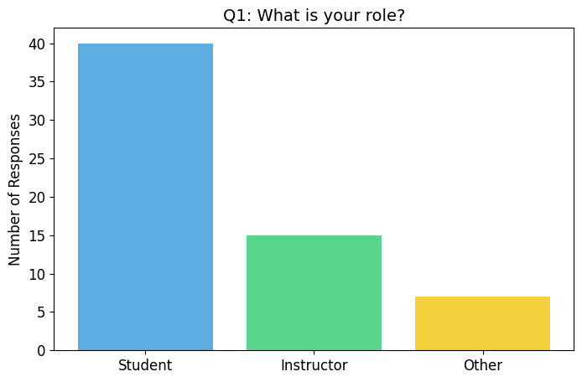
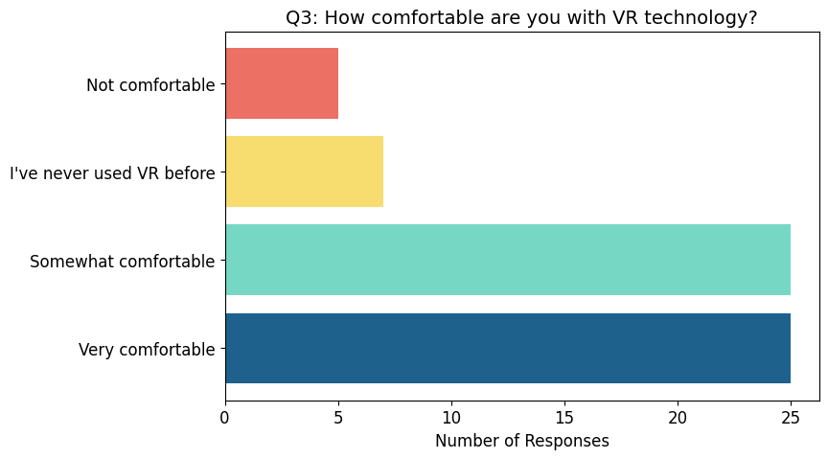
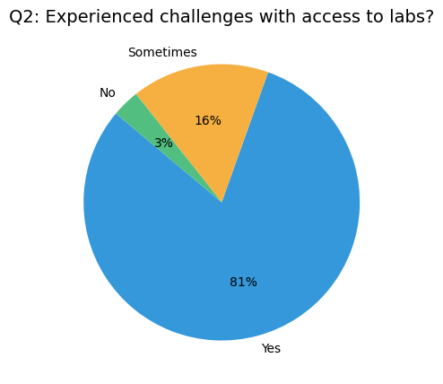
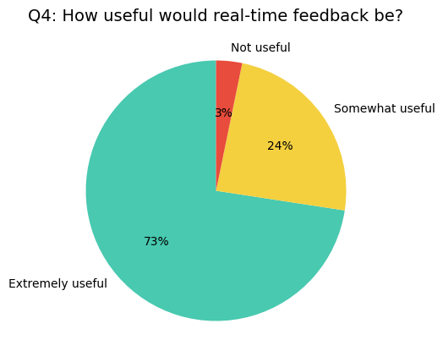
Questionnaires Results

Slide 5
Project - Assumptions & Constraints
Assumptions
Constraints
Hardware Limitations: High-performance computers (Intel i7, 16GB RAM, NVIDIA RTX 20) are required for smooth VR, which may limit access.
Time and Budget Constraints: Development must be completed within six months and on budget, affecting scope.
Platform Dependency: System relies on Oculus VR frameworks, limiting compatibility with non-supported devices.
Real-Time Performance: Low latency (<100 ms) is needed for real-time interactions, which could be a challenge in areas with slow internet speeds.
User Engagement: The platform’s success depends on the willingness of students and instructors to adopt and use VR technology.
Content Localization: Adapting the platform for different languages and regions may add development complexity and cost.
VR Hardware Availability: All users will have access to MetaQuest Pro VR headsets and compatible computers.
Stable Internet Connection: Reliable internet (10 Mbps) will be available for smooth real-time interaction.
User Technical Skills: Users will have basic VR and chemistry knowledge or receive training.
Platform Scalability: The system can scale to support more users without performance issues.
Curriculum Stability: The national chemistry curriculum will remain stable and aligned with the platform’s experiments.

Slide 6
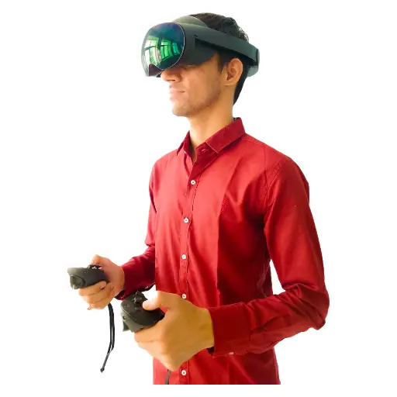
Requirements Specifications

Slide 7
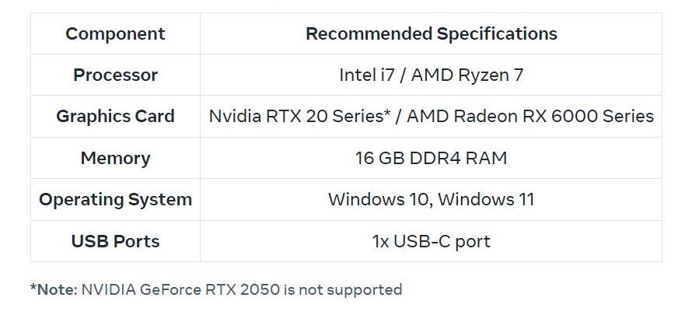
Recommended PC Requirements

Slide 8
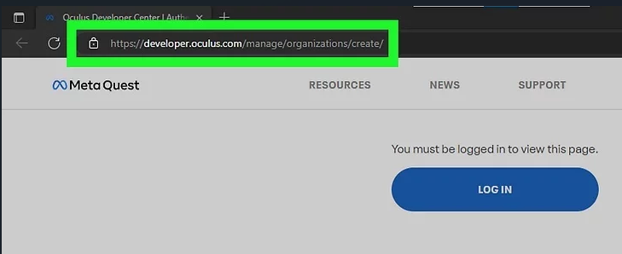
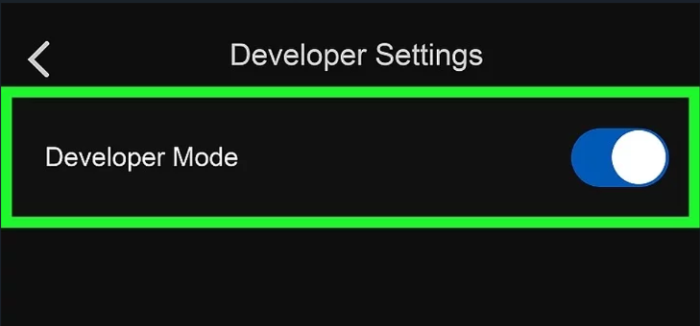
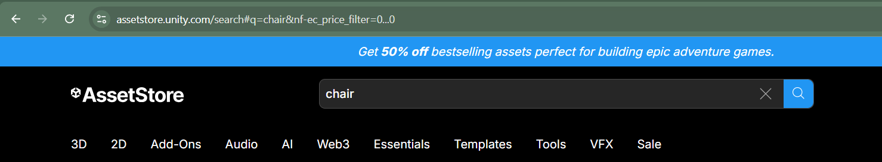
Development in VR
Create developer account
Turn on developer mode in VR headset
Asset store to find some materials.

Slide 9
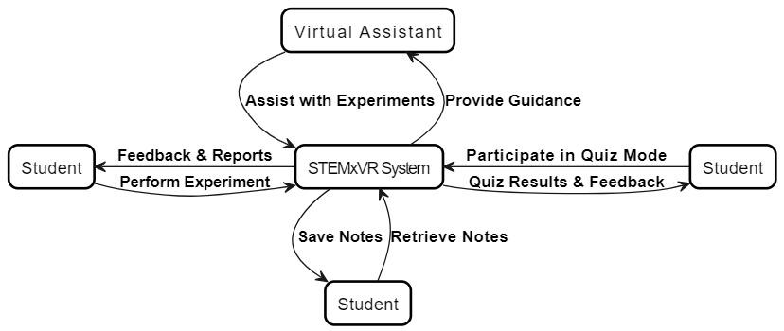
Context Diagram / High Level Block Diagram

Slide 10
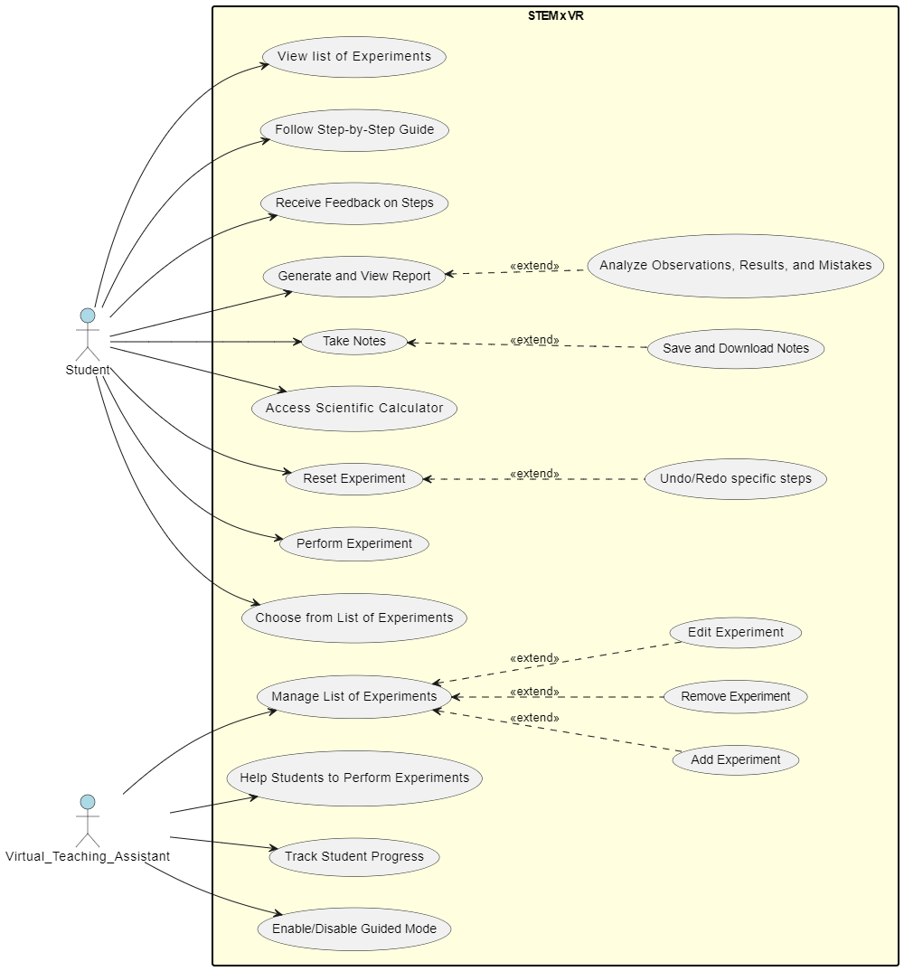
Use Case Diagram
Actors: Student, Virtual Teaching Assistant
Key Functionalities:
Student: View experiments, Follow guides, Receive feedback, Generate reports, Take notes, Reset experiments, Perform tasks
Virtual Teaching Assistant: Manage experiments, Assist students, Track progress, Control guided modes
Purpose: Enhance interactive learning in virtual chemistry experiments.

Slide 11
Feature Set Matrix
Feature / Use Case​ | Priority of Development​ | Feature / Use Case​ | Priority of Development​
FR1: Students should be able to select and conduct virtual experiments from a list of available experiments | High | FR7: Students should be able to reset an experiment at any point or undo/redo specific steps. | High
FR2: Students must be able to use a step-by-step guide to follow instructions for each experiment.​ | High | FR8: Students shall be able to participate in a quiz mode, where they perform experiments without step-by-step instructions. | Low
FR3: Students should be able to receive instant feedback on the accuracy of their steps during the experiment. | Low | FR9: Assistant should be able to track students' progress and completion of experiments. | Low
FR4: Students should be able to generate and view a report of the experiment, including observations, results, and mistakes. | Low | FR10: Assistant shall be able to assist students in performing experiments (guided mode, video demo). | Medium
FR5: Students should be able to take notes during the experiment, with the option to save and retrieve these notes. | Medium | FR11: Assistant should be able to manage the list of experiments available to students, including adding, removing, or editing experiments. | High
FR6: Students should be able to access a built-in scientific calculator to perform calculations during experiments. | Medium

Slide 12
Distinguishing Requirements
Functional
Non-Functional
Latency: < 100 ms
Internet Speed: ≥ 10 Mbps per user
User Capacity: Multiple users simultaneously without degradation
Hardware Specifications: Intel i7 processor, 16GB RAM, and NVIDIA RTX 20 Series*
Students should be able to select and conduct virtual experiments from a list of available experiments.
Students must be able to use a step-by-step guide to follow instructions for each experiment.
Students should be able to reset an experiment at any point or undo/redo specific steps.
Assistant should be able to manage the list of experiments available to students, including adding, removing, or editing experiments.
Students should be able to take notes during the experiment, with the option to save and retrieve these notes.
Students should be able to access a built-in scientific calculator to perform calculations during experiments.
Assistant shall be able to assist students in performing experiments (guided mode, video demo).

Slide 13
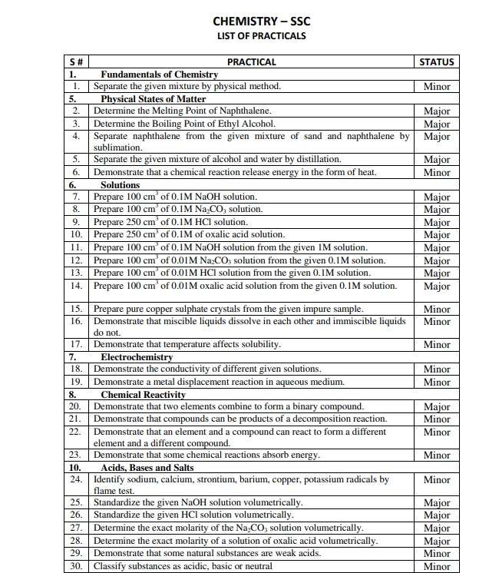
List of Experiment

Slide 14
Project Design
System Architecture & UML Diagrams

Slide 15
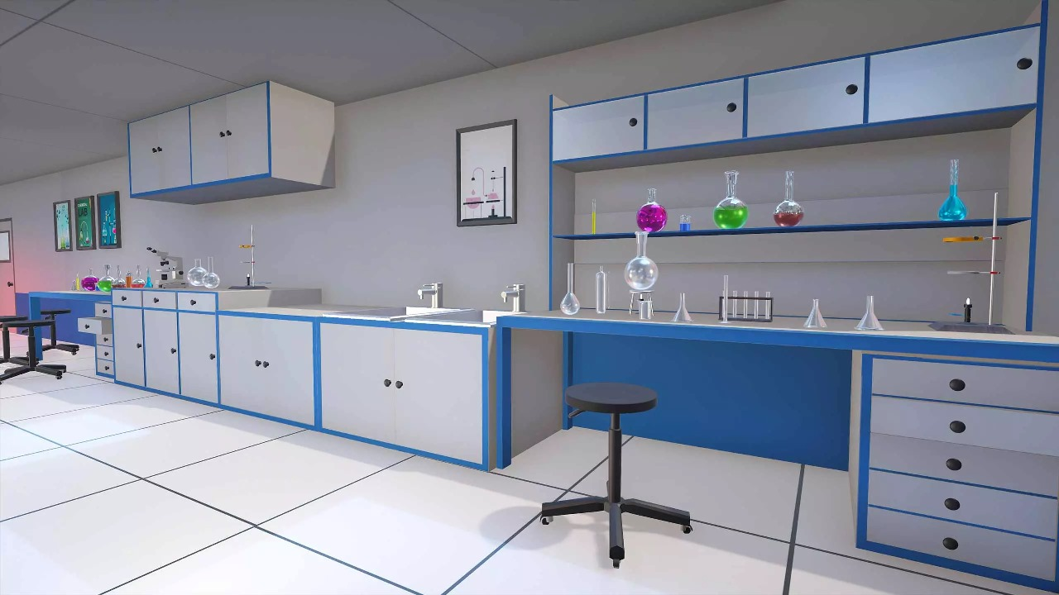
User Interface 1

Slide 16
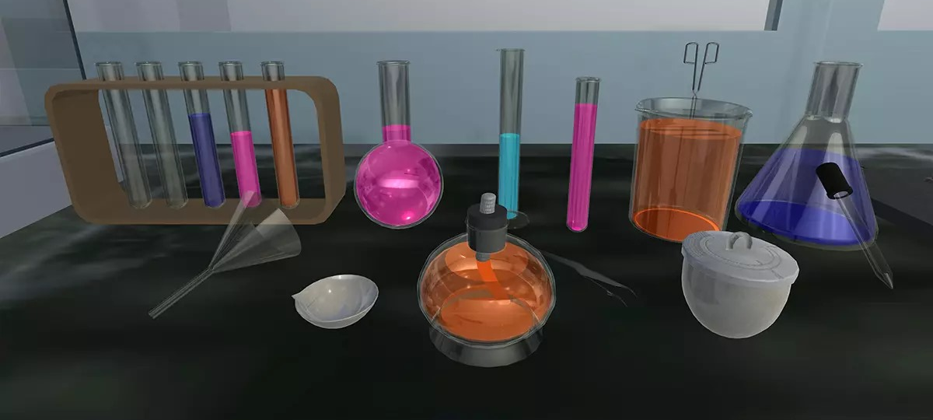
User Interface 2

Slide 17
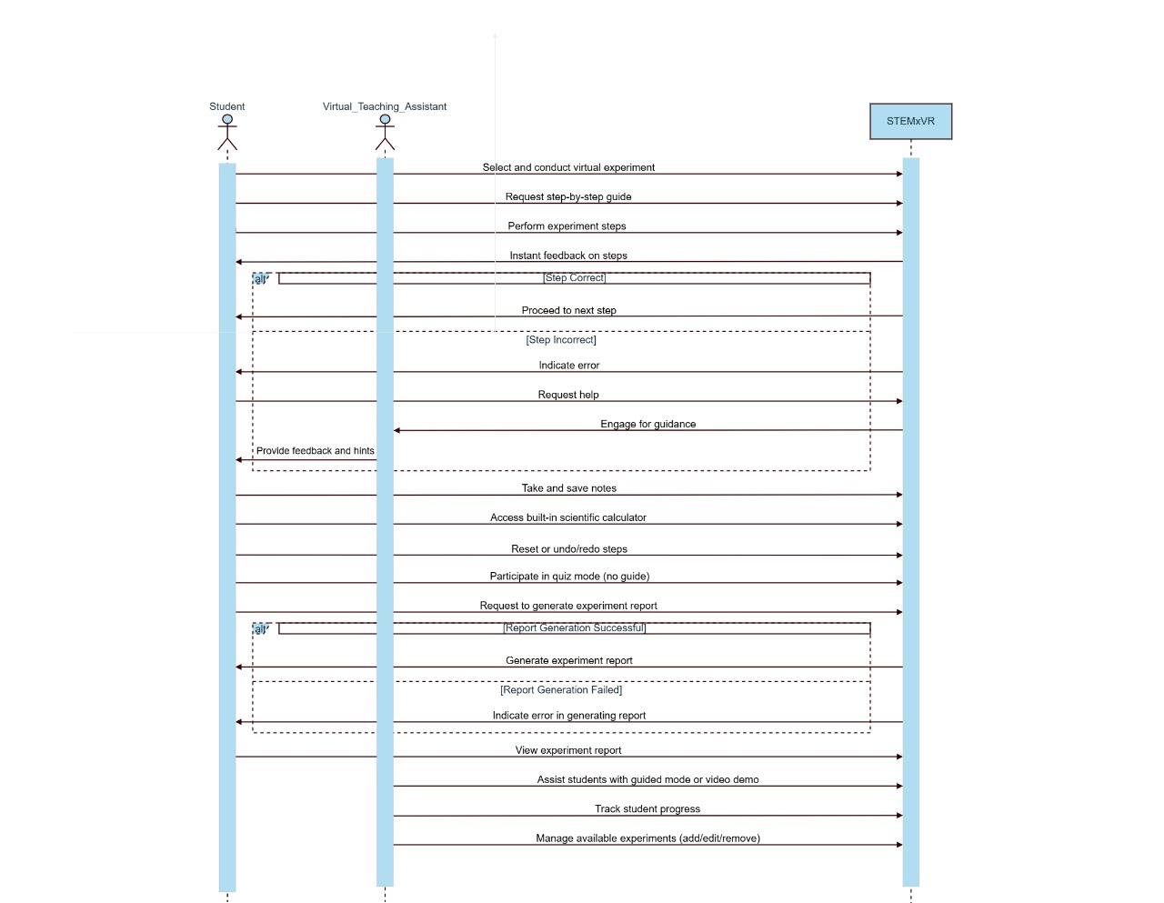
Logical View Sequence Diagram

Slide 18
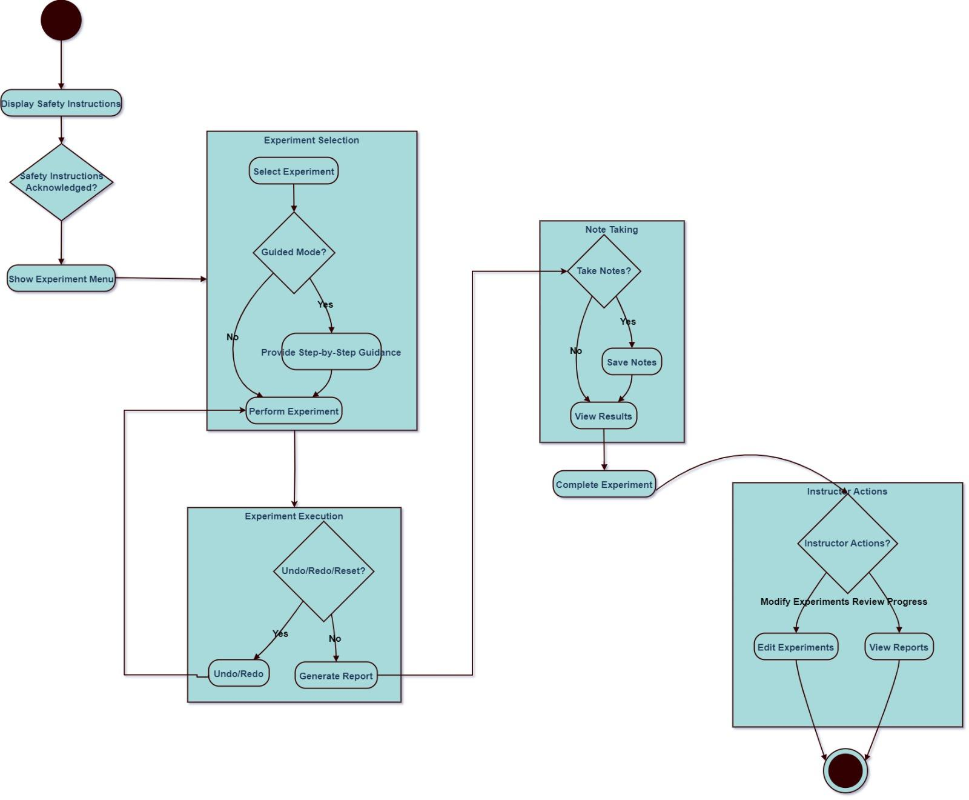
Process View Activity Diagram

Slide 19
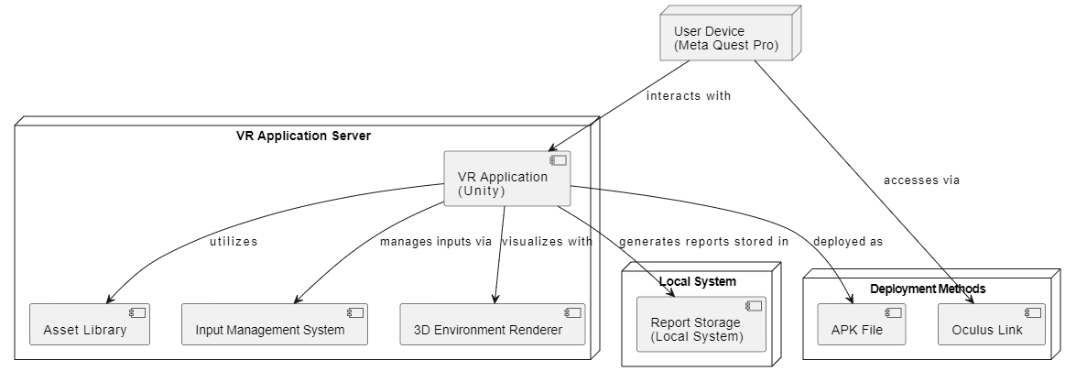
Physical View Deployment Diagram

Slide 20
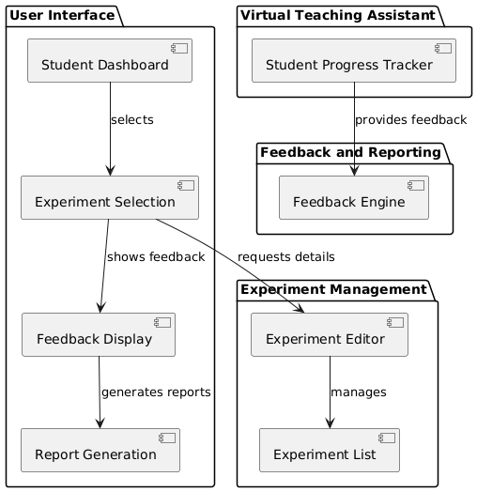
Development View Component Diagram

Slide 21
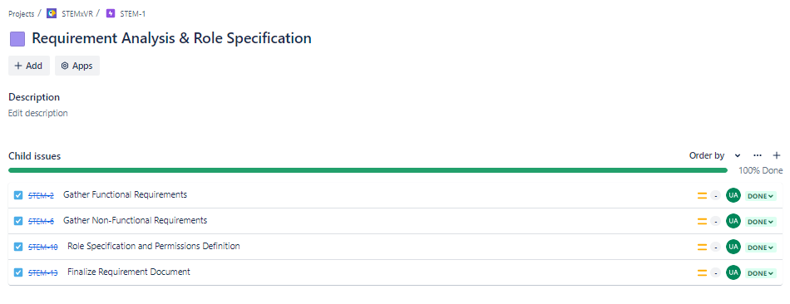
Project Management
Management Tool - JIRA(EPIC 1)

Slide 22
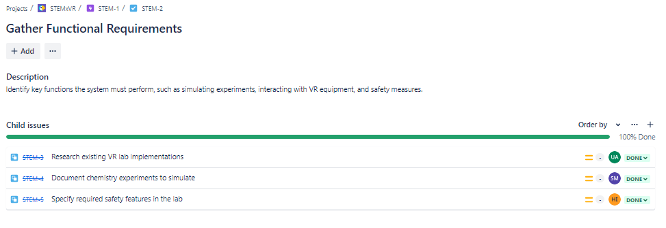
Project Management
Management Tool - JIRA(Sprint 1)

Slide 23
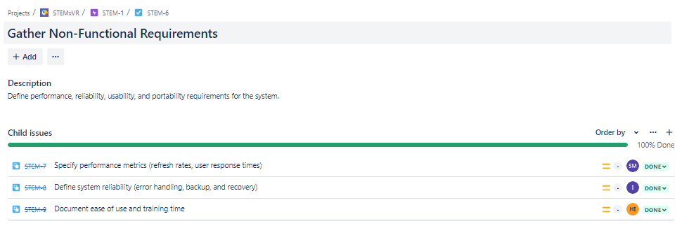
Project Management
Management Tool - JIRA(Sprint 1)

Slide 24
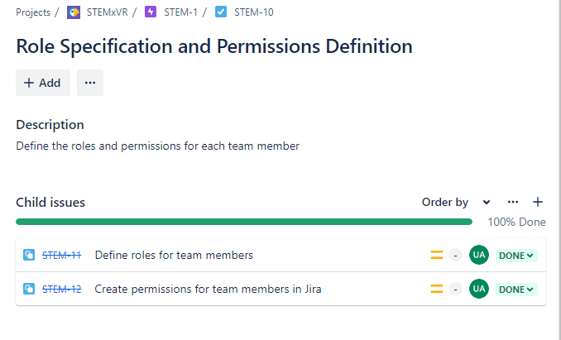
Project Management
Management Tool - JIRA(Sprint 2)

Slide 25
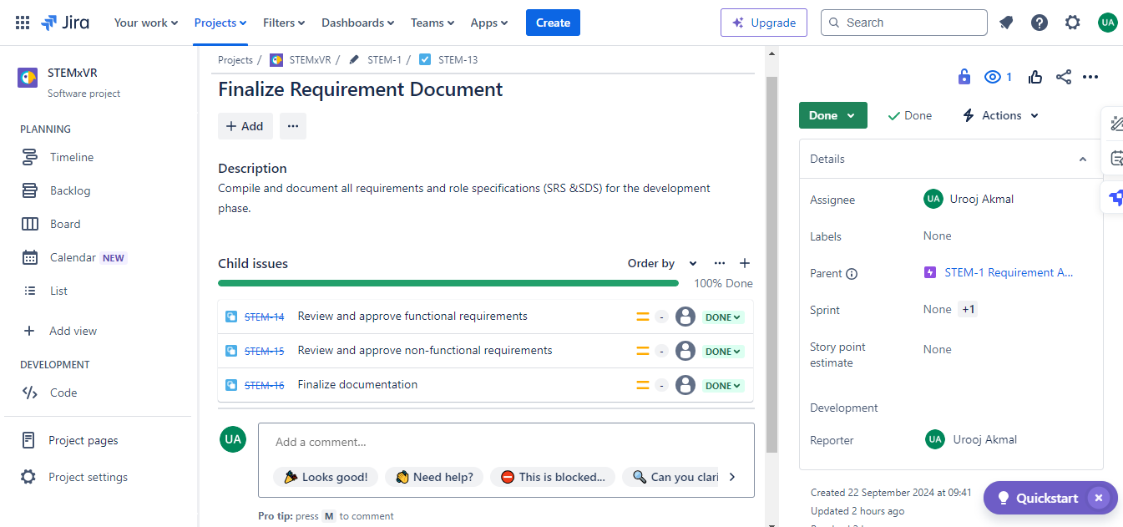
Project Management
Management Tool - JIRA(Sprint 3)

Slide 26
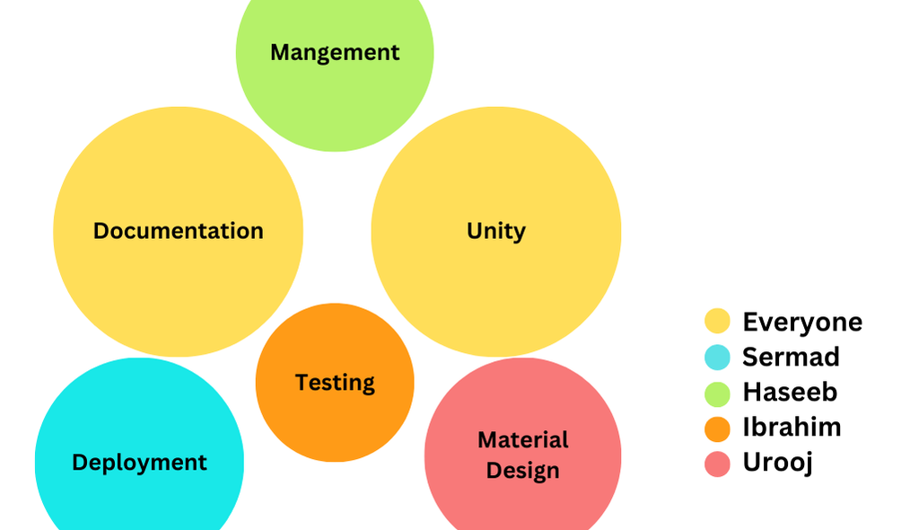
Project Division
Project Division And Responsibilities assigned

Slide 27
THANK YOU!

